Slide 1
Corporate Presentation
Q1 2023

Slide 2
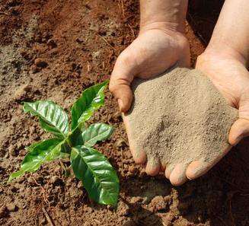
OVERVIEW
Focused on growth & profitability
Targeting invoiced sales of 200kt for 2023 up from 150kt in 2022
Completed storage expansion project to support higher sales volumes
Cashflow positive at an overall level forecast to continue
Robust fertiliser market driven by a confluence of factors
Surging input costs
Supply disruptions caused by sanctions
Increasing demand to support growing world population
Building profile of KP Fértil®
Gaining traction in multi-mtpa market on the doorstep
Expanding geographic reach
Multi buying options enabling wide variety of customers
Exemplary ESG credentials
Organic product with minimum environmental impact
Focus on becoming carbon free
Helping customers achieve their own sustainability targets

Slide 3
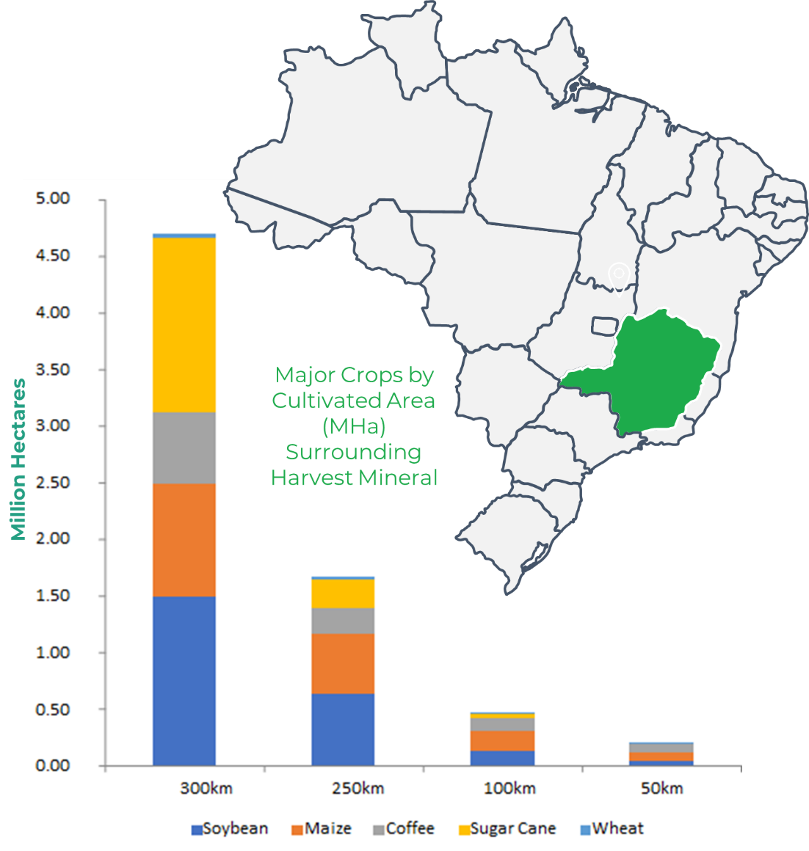
THE OPPORTUNITY
Positioned to capitalise on the imbalance of fertiliser supply demand dynamics in Brazil
c.85% of Brazil’s fertiliser is imported making it vulnerable to market oscillations (Anda) | The Brazilian Ministry of Agriculture aims to reduce fertiliser imports to c.45% by 2050 | Brazil imported 16.6Mt of fertilizers Jan-May 2022, 16.5% more compared to the same period in 2021 (Cargonave) | +70% of fertiliser used in Brazil is applied to 3 crops, - soybean, sugarcane, & maize, which are some of the major crops grown near Arapuá (USDA)
Brazil is the world’s 3rd largest exporter of agricultural products but needs to produce 76% more grain & 41% more oilseeds in 2031 than it did in 2021 to meet projected demand | 60% more food needs to be produced by 2050 to feed a world population of 9.3 billion (FAO) | The fertilizer market is projected to grow an estimated compound annual growth rate of 3.8% making this industry a potentially excellent long-term investment. | The global fertiliser market size is forecasted to reach US$251.6bn by 2030 (Allied Research)

Slide 4
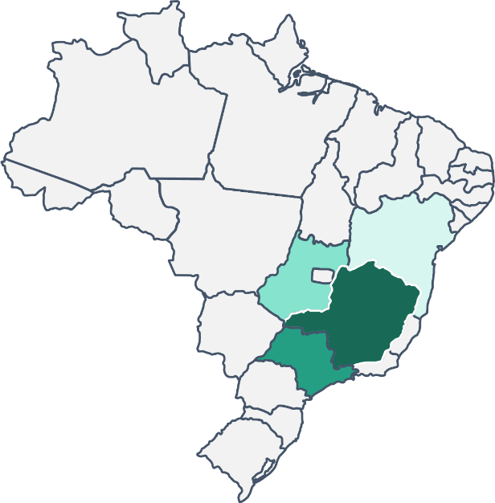
SALES
83% CAGR in invoiced sales over the last three years
Sales by product & location
Most sales are made to customers in the immediate vicinity of Arapua
Key buying periods
Slight distortion to usual buying periods in 2022 with farmers bringing forward buying decisions to ensure they get allocations
 | Jan | Feb | Mar | Apr | May | Jun | Jul | Aug | Sep | Oct | Nov | Dec
Coffee
Sugar Cane
Pasture
Soybean
Maize
Hortifruti
Compost
Compost (Manure)
Sorghum
Beans
*Compound Annual Growth Rate

Slide 5
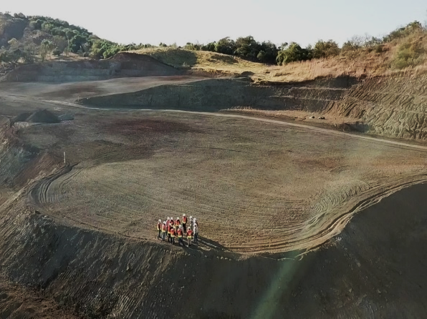
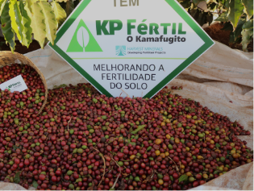
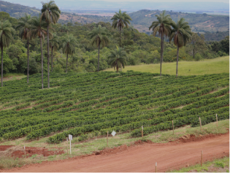
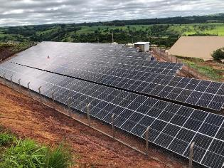
PROJECT, OPERATIONS & GROWTH
Weathered kamafugite lava naturally rich in K and P as well as Ca, Mg and other micronutrients
100+ years of known resources
Licensed to produce 400kt – invoiced sales in 2022 of 150kt & 2023 target of 200kt
Simple mining & processing utilising modular plant - product excavated & trucked to the storage area, homogenized, crushed, bagged, loaded, & ready to sell
Operates at 24-hour, three-shift production scale at peak demand
Increased product storage capacity to 2 x 25kt covered storage facilities over 6,000 sq m to enable stockpiles of dry material during the rainy season to meet growing demand
Excellent results at trial farm demonstrating first-hand the effectiveness of KPFértil across all key crops including the production of award winning coffee

Slide 6


ESG COMMITTED
Implemented Net Zero Strategy
Natural, organic product with minimal environmental impact
No water used during production & no tailings disposal
No contaminants including chloride & salt
Low leaching reduces groundwater contamination
Slow release product with residual effect
Low carbon emissions
Used locally meaning that very little transport is required
Product increases crop yields & productivity, with benefits including reducing the need for deforestation
A carbon-free company
New solar power facility provides all the power requirements
Off-set initiatives include planting thousands of native trees
Received the London Stock Exchange’s Green Economy Mark, which recognises Harvest’s contribution to the global green economy & efforts to support the transition to a net zero economy.
Input Approval Programme in accordance with main organic production guidelines (US, European, IFOAM, Japanese, Canadian, Brazilian & Demeter Standards).

Slide 7






INVESTMENT CASE
LONG-LIFE, FLAGSHIP PROJECT Organic fertiliser project located in the heart of Brazil’s agricultural market | BUILDING SALES & REACH Strong invoiced sales showing 83% CAGR over the last 3 years anticipated to continue | STRENGTHENING BALANCE SHEET Revenue generating, low cost & high margin operation
STRONG MARKET FUNDAMENTALS The global fertilizers market projected to register a CAGR of 3.8% during 2022-2027 | ROBUST ESG CREDENTIALS Carbon-free company delivering certified organic product | EXCEPTIONAL TEAM Proven in-country and operational experience with extensive network

Slide 8
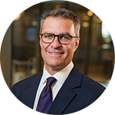
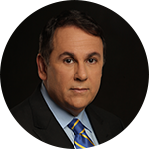
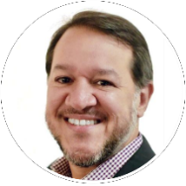
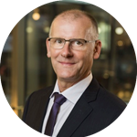
BOARD OF DIRECTORS
Brian McMaster, Executive Chairman
+25 years’ experience in corporate reconstruction, turnaround, and performance improvement, alongside c.25 years in the mining industry.
Founder of several ASX-listed companies and managed the reorganisation, recapitalisation and listing of +20 companies.
Founding director of venture capital and advisory firm Garrison Capital Pty Ltd.
Luis Azevedo, Executive Director
+25 years of mining experience in Brazil. P.Geo, a lawyer, and an independent member of several TSX-ASX listed companies.
Founder & Managing Partner of FFA Legal, focused on natural resources companies.
Co-Founder of Avanco Resources sold to Oz Minerals for $430 million.
VP of the Brazilian National Conference of Industry’s Mining Council.
Alex Penha, Non-Executive Director
+18 years mining capital markets experience.
Founder & Director 4B Mining Corp., EVP Corporate Development Bravo Mining Corp; former EVP Rio Verde Minerals, Rio Novo Gold, CFO GK Resources.
Jack James, Non-Executive Director
+20 years’ experience in chartered accounting specialising in corporate advisory and reconstruction.
A partner of Palisade Business Consulting, which provides accounting, secretarial & advisory services to private/ public companies, government & other stakeholders.
BA Business from the Queensland University of Technology & a CA.

Slide 9
CONTACTS
www.harvestminerals.net
UK office
Level 1
20 North Audley Street
London, UK
Brazilian office
Av. Jornalista Ricardo Marinho 360, sala 113
Ed. Cosmopolitan Barra da Tijuca
Rio de Janeiro, Brazil
www.linkedin.com/company/harvest-minerals/
@HarvestMinerals

