Slide 1
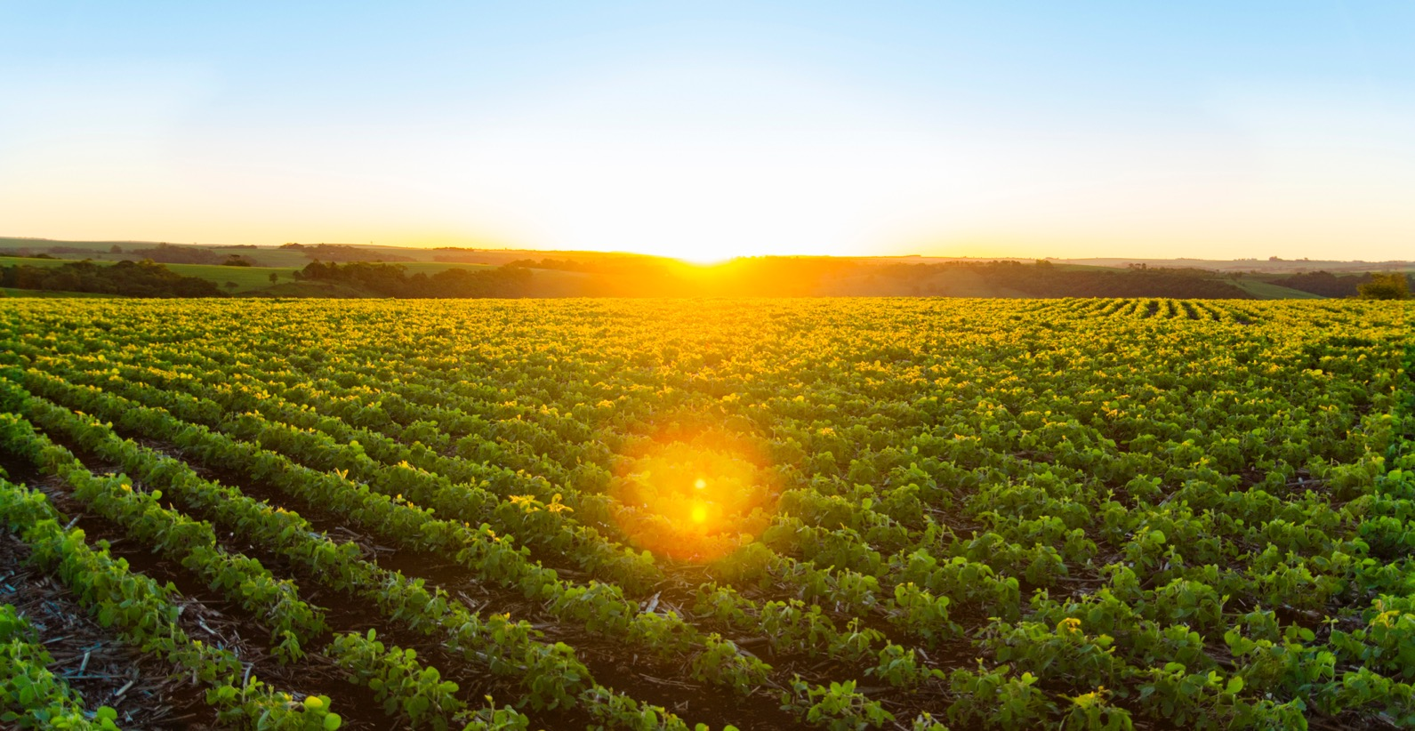

A high margin, natural fertiliser producer & developer in Brazil
Corporate Presentation
Q1 2022

Slide 2
Looking Forward Statements
The information in this presentation is an overview and does not contain all information necessary for investment decisions. In making investment decisions in connection with any acquisition of securities, investors should rely on their own examination of Harvest Minerals Limited (HMI or the Company) and consult its own legal, business and/or financial advisers.
The information contained in this presentation has been prepared in good faith by Harvest Minerals Limited, however no representation or warranty expressed or implied is made as to the accuracy, correctness, completeness or adequacy of any statements, estimates, opinions or other information contained in this presentation. To the maximum extent permitted by law, Harvest Minerals Limited, its directors, officers, employees and agents disclaim liability for any loss or damage which may be suffered by any person through the use or reliance on anything contained in or omitted from this presentation.
Certain information in this presentation refers to the intentions of the Company, but these are not intended to be forecasts, forward looking statements or statements about future matters for the purposes of the Corporations Act or any other applicable law. The occurrence of events in the future are subject to risks, uncertainties and other factors that may cause the Company’s actual results, performance or achievements to differ from those referred to in this presentation. Accordingly, Harvest Minerals Limited, its directors, officers, employees and agents do not give any assurance or guarantee that the occurrence of the events referred to in the presentation will occur as contemplated.

Slide 3
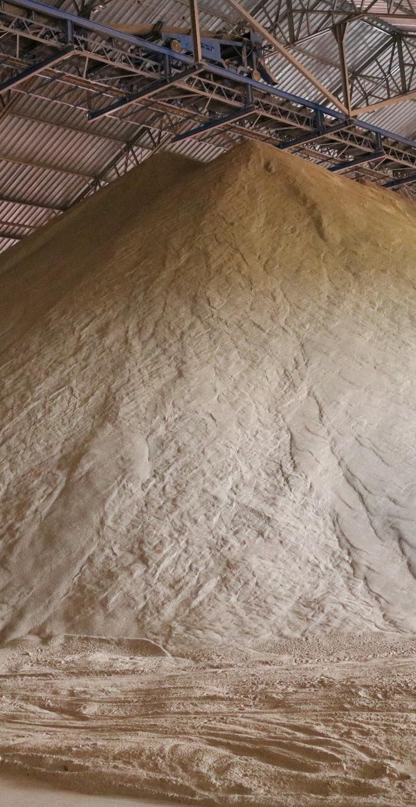
Overview
Rapidly Building Production & Sales At Flagship Project, Arapua
Proven high margin product – organic certified and non-GMO multi-nutrient fertiliser and soil remineraliser provides competitive and cost-effective crop yields compared to traditional fertilisers
Simple & cost-effective production – free digging, no waste mining, material crushed then ready for delivery & application
Ideal location – surrounded by world’s fastest growing agricultural jurisdiction with multi-mtpa market on doorstep
Growing sales – 46% CAGR over the last three years supported by continuous agronomical performance tests and robust sales and marketing team
ESG Committed
Minimum environmental impact
First Brazilian company to be awarded The London Stock Exchange’s Green Economy Mark
Initiatives to become carbon free include a solar power facility
Focused On Growth & Profitability
Portfolio of complementary assets include phosphate and limestone projects

Slide 4


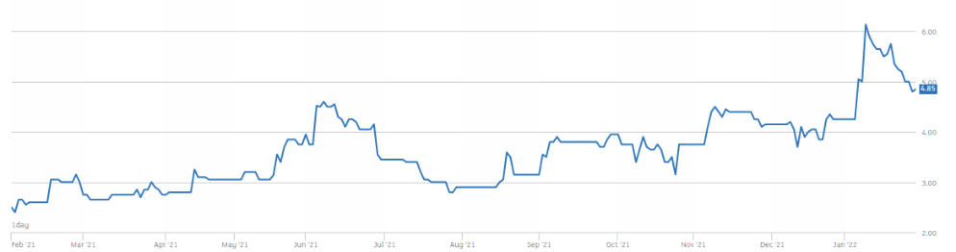


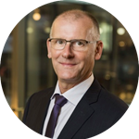


Leadership & Corporate Structure
Brian McMaster, Executive Chairman
+25 years’ experience in corporate reconstruction, turnaround, and performance improvement, alongside c.25 years in the mining industry.
Founder of several ASX-listed companies and managed the reorganisation, recapitalisation and listing of +20 companies.
Founding director of venture capital and advisory firm Garrison Capital Pty Ltd.
Luis Azevedo, Executive Director
+25 years of mining experience in Brazil. P.Geo, a lawyer, and an independent member of several TSX-ASX listed companies.
Founder & Managing Partner of FFA Legal, focused on natural resources companies.
Co-Founder of Avanco Resources sold to Oz Minerals for $430 million.
VP of the Brazilian National Conference of Industry’s Mining Council.
Alex Penha, Non-Executive Director
+15 years mining capital markets experience.
Founder & Director 4B Mining Corp., former EVP Rio Verde Minerals, Rio Novo Gold, CFO GK Resources.
Jack James, Non-Executive Director
+20 years’ experience in chartered accounting specialising in corporate advisory and reconstruction.
A partner of Palisade Business Consulting, which provides accounting, secretarial & advisory services to private/ public companies, government & other stakeholders.
BA Business from the Queensland University of Technology & a CA.
Key Information* | AIM:HMI
Ordinary Shares in Issue | 189,169,217
Market Cap | £9.1 million
Share | 4.8p
*As at 31 Jan 2022
In-Country Support
20 years as reference in providing complete and specialised services to mining companies and projects in Brazil https://en.ffalegal.com.br/ffa
Nomad Broker

Slide 5
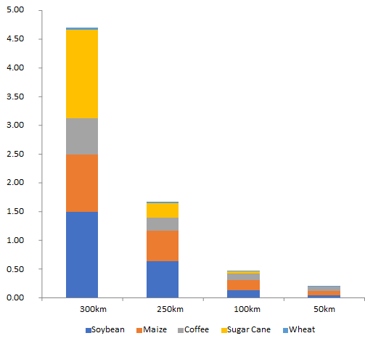

The Opportunity
Positioned to capitalise on the imbalance of fertiliser supply demand dynamics in Brazil
Flagship project
located in the core
of the Brazilian agricultural belt in the Carmo do Paranaíba Municipality, in the northwest of Minas Gerais
+3Mtpa
of coffee produced within 300km of Arapuá
Major Crops by Cultivated Area (MHa) Surrounding
Harvest Mineral
Double digit growth
in most of the crops targeted by Harvest forecast by several sector associations
83%
of all fertiliser used in Brazil is applied to soybean, sugarcane, maize and coffee, which are the major crops grown close to Arapuá
Million Hectares
+4.5m
hectares of soybean, sugarcane, maize and coffee within 300km radius of Arapuá

Slide 6
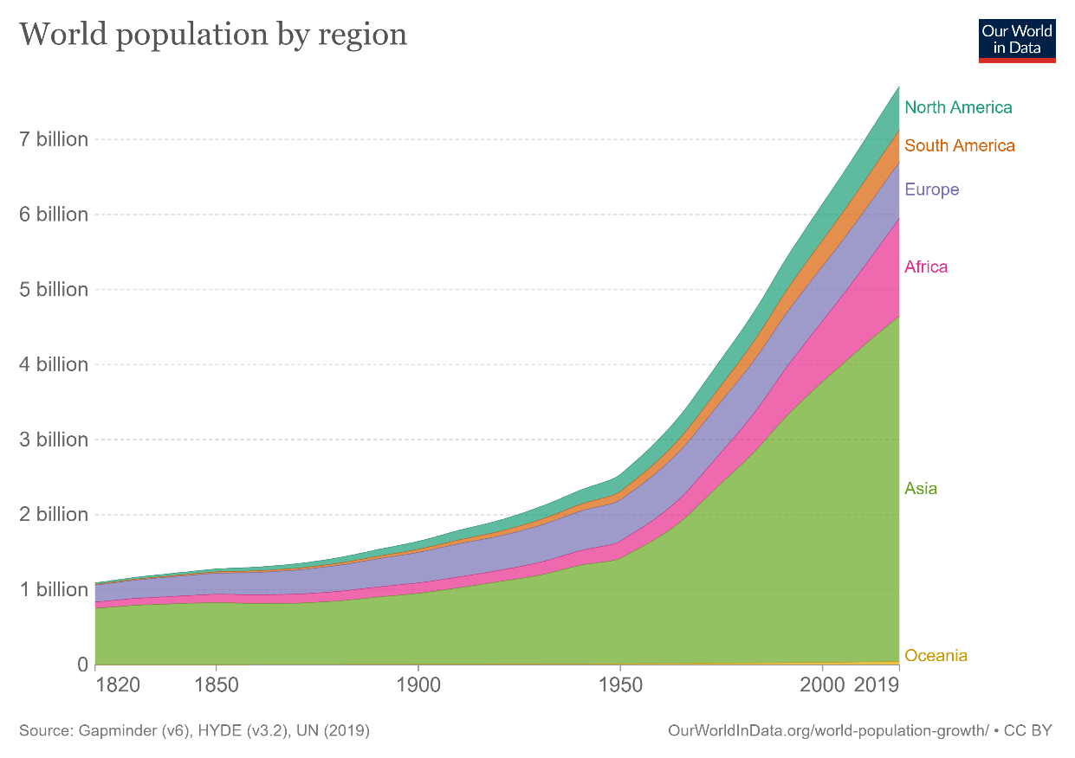
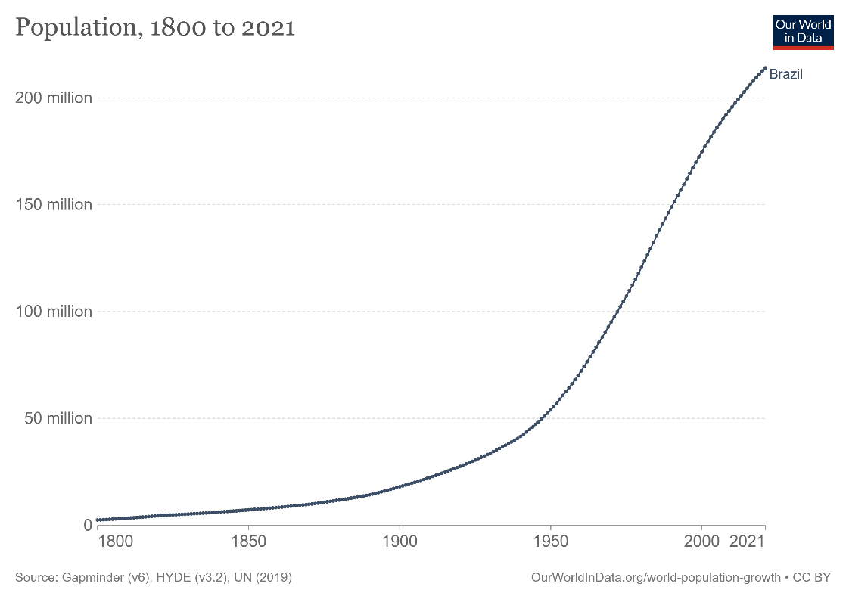
Feeding An Increasing Population
In the last two centuries, Latin America’s population
increased 28 fold.
Brazil is one of the top 5 most populous countries globally

Slide 7
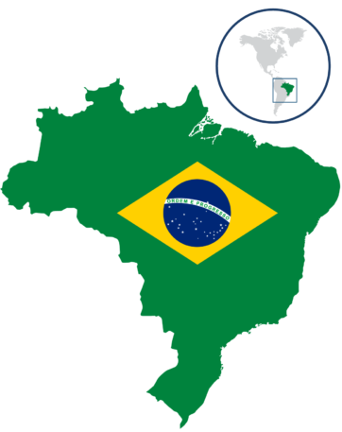
Brazil’s Fertiliser Market
Fear over food supply is creating a boom for fertilisers as farmers look to ramp up production
+8%
of Brazil’s GDP is represented by the agricultural sector & 10% of total employment in the country
80%
of Brazil’s fertiliser is imported making it vulnerable to market oscillations
+30%
of the world’s coffee beans are produced in Brazil, which is also the world’s largest producer and exporter of soybean and sugar
Imported volumes of fertiliser reached a record
38.3Mt
from January to November 2021 (2020: 34.2Mt)
Brazil is one of the top
4
consumers of fertiliser globally
The Ministry of Agriculture aims to reduce fertiliser imports to circa
60%
in the next 30 years

Slide 8
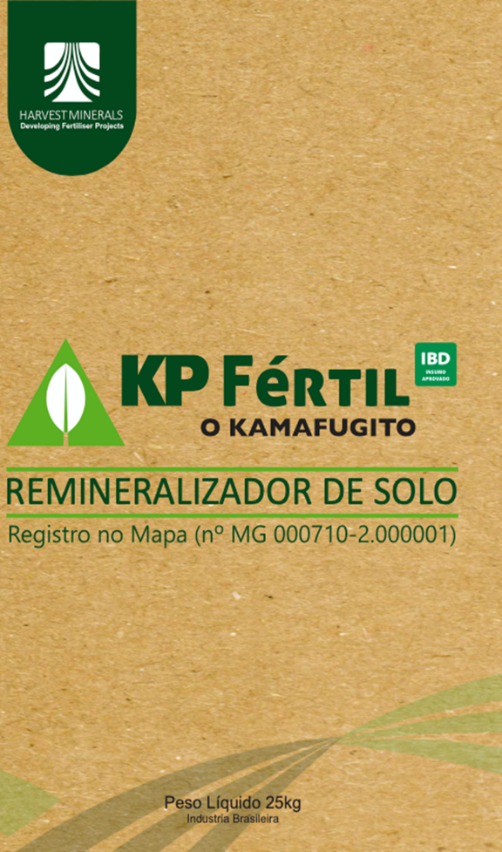
Why KP Fértil®
A new natural remineraliser containing macro/micronutrients essential for plant growth and soil fertility
100% Organic with no chemicals
IBD Certified Latin America’s largest certifier of organic products recognized internationally
Multi-market potential can be used in organic and non-organic farms, therefore capturing both markets
Slow-release source of K, P, Ca, Mg & other micronutrients
Rebalances soil pH and improves uptake of water and nutrients
Minimal losses via leaching
No salt, chloride or chemicals
Improves crop yield & quality
Agronomic test work confirmed the effectiveness of KPFértil on:
Soybean
Coffee
Sugar Cane
Maize
Pasture
Marketing Solutions To Fit Any Budget

Slide 9
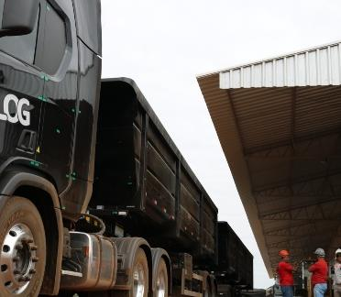
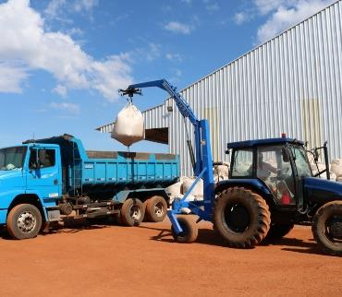
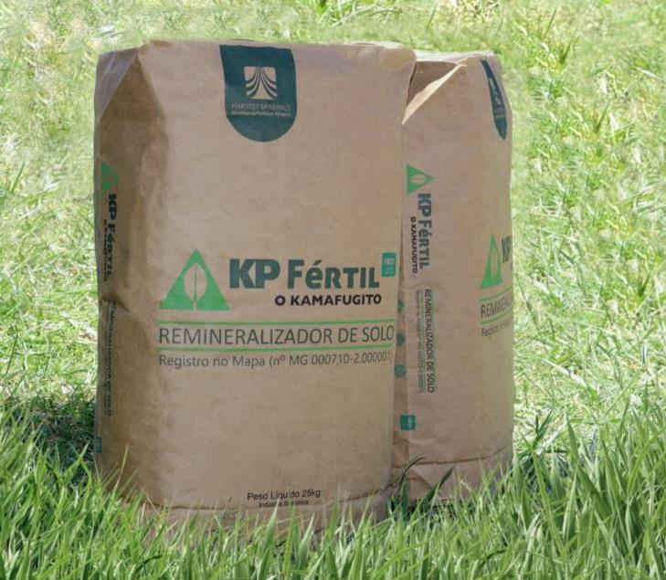
KP Fértil® Marketing Channels
www.kpfertil.net.br
11 associates/agronomists split into two regional teams plus third-party network of 20 resales centres
Diversified marketing channels including 25kg-bag packaging that drive high profitability margins
13-50 Tonne Bulk
1 Tonne Bigbags
25kg Bags
Large coffee and grains’ farms
General retail markets and resales
Gardening, small producers and farmers, fruit and vegetables, general retail markets and resales

Slide 10
KP Fértil® Sales
Total Sales
Substantial sales orders for 2022 started to be placed towards the end of 2021
Sales by Product & Location
Most sales are made to customers in the immediate vicinity of Arapua
Sales performance represents a 46% CAGR (Compound Annual Growth Rate) over the last three years
Key Buying Periods
Most orders are placed in the second half of the year resulting in sales seasonality
 | Jan | Feb | Mar | Apr | May | Jun | Jul | Aug | Sep | Oct | Nov | Dec
Coffee
Sugar Cane
Pasture
Soybean
Maize
Hortifruti
Compost
Compost (Manure)
Sorghum
Beans

Slide 11
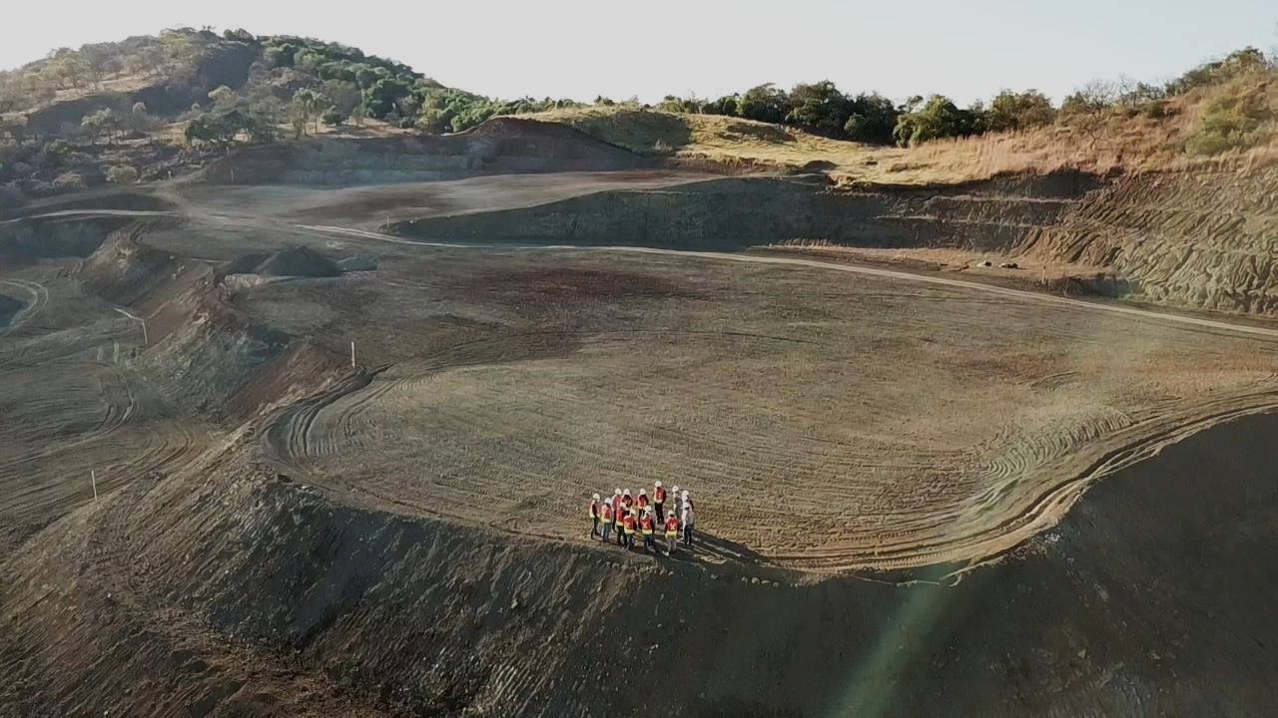
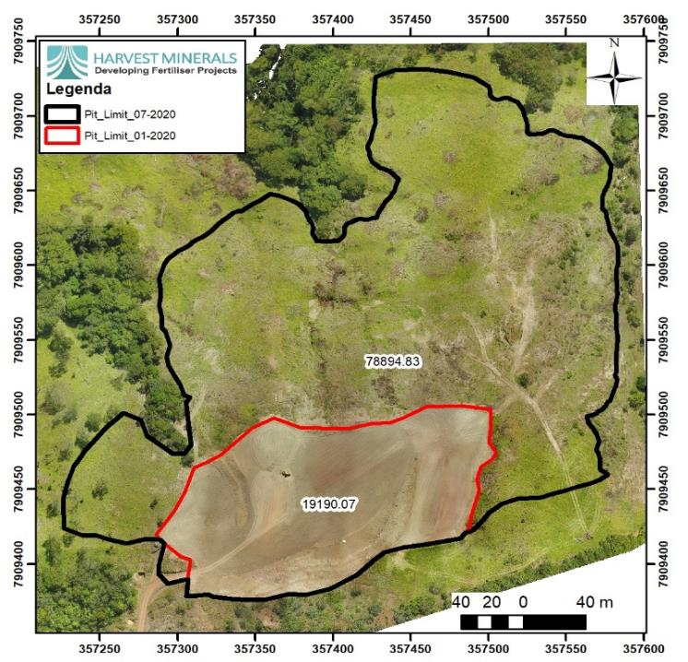
Arapuá Mine
Weathered kamafugite lava - naturally rich in K and P as well as Ca, Mg and other micronutrients
JORC (2012) Indicated and Inferred Resource of 13.07Mt at 3.1% potassium oxide (K2O) and 2.49% phosphorous (P2O5)

Slide 12
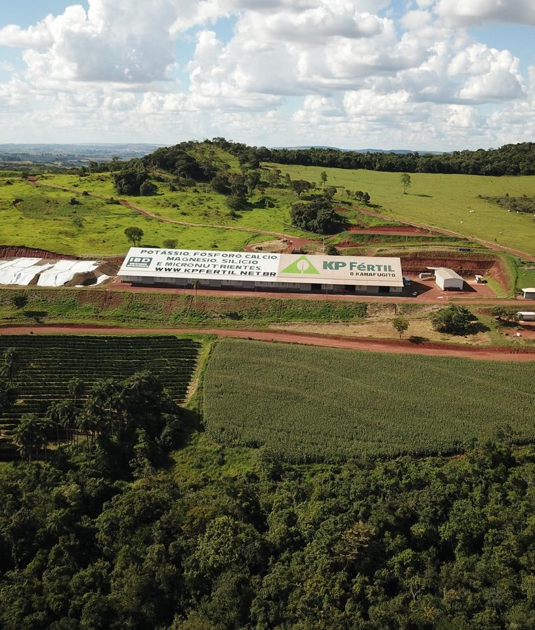
Operations
Modular plant allowing for simple, cost-effective production - product excavated and trucked to storage area, homogenized, crushed, bagged/loaded and ready to sell
Environmental License allows Harvest to produce up to 400ktpa – 2022 target of 150ktpa
Operates at 24-hour, three-shift production scale at peak demand
Product storage capacity of 30,000 tonnes over a 6,000 sq m total storage covered area – this is essential to enable stockpiles of dry material during the rainy season to meet growing demand
Known mineralisation guarantees 100+ years of production at current rates

Slide 13
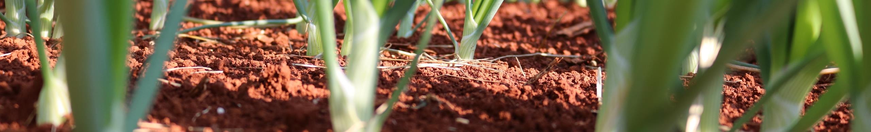
Timeline – From Resources to Production in Two Years
Focused on building product awareness & annual sales
2016-2017
2018
2019
2020
2021
The Beginning
The Ramp-up
Product Awareness
Platform Consolidation
Focus on Sales
Start of Project Development
Scoping Study delivered
Trial Mining License awarded
Soft marketing of KPFértil commenced and first sales
Raised £9.7 million
Received MAPA approval and organic registration
Expanded project and processing capacity
Established Sales and Marketing Team
Increased Sales and market penetration
Switched to Grid Power
Awarded full mining and environmental permits
Expansion of Mining Product storage capacity
Completion of key Ag. Tests on various crops
Marketing campaign for coffee, sugarcane, and other crops launched
Expanded sales team and new target regions
Hit 85,000 tonnes in sales

Slide 14
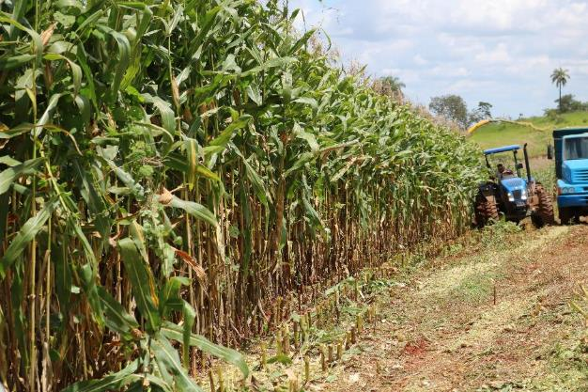
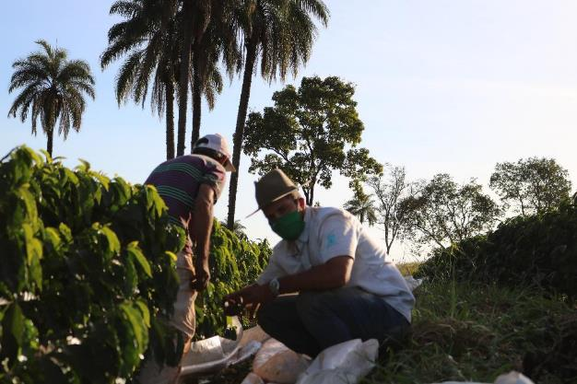
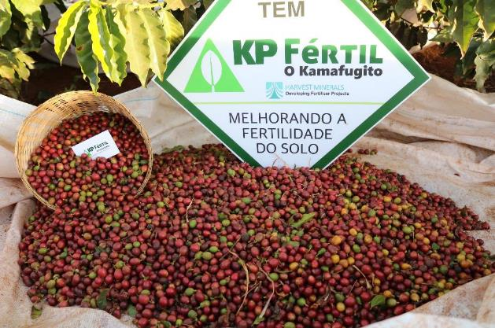
Arapuá Showcase Farm
Farm established at Arapua in 2018 to demonstrate sustainable benefits of KP Fértil to existing and new customers
Objectives
To test KPFértil on multiple crops (sugarcane, coffee & grains including soybean & corn) to support verified independent research and better understand the product
To increase awareness and knowledge about the positive economic and environmental effects of using an organic fertiliser in local agricultural production
Strategically located next to the mine and close to KP Fértil loading bay, the farm has also been the focus of reforestation activities having planted 18,000 native trees in the area during 2021
Case Study: Coffee
Catuai Vermelho 144 variety coffee planted at the farm in sub-standard conditions (low altitude, bad soil) and treated with KPFértil
Coffee produced proven in 2021 to be ‘Speciality’ having reached 87 SCAA points (specialty coffee should score over 80 pts on a 100-point scale by the Specialty Coffee Association of America)
Coffee won sixth place in prestigious Brazilian Carmocer Contest, while first place was won by Ricardo Bartholo, a Harvest client who also uses KPFértil; following the win, a 60kg bag of his coffee was sold at the associated auction for R$55,000,00.

Slide 15
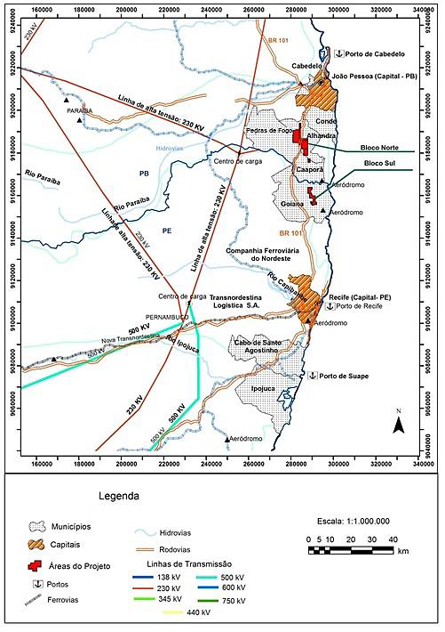
Growth – Miriri Phosphate Project
Advanced stage phosphate project acquired in December 2021 with historical non-compliant resources of 4.8Mt at 4.19% P2O5
Developed to date by the Brazilian Geological Agency, CPRM, which has executed substantial exploration work
Amenable for development of a Direct Application Natural Fertiliser ("DANF") operation at low capex and opex like Arapua, which also ticks the sustainability box
Excellent infrastructure in place, such as roads, ports, power, water, workforce, and markets
Expands Harvest’s reach to the northeast region of Brazil
Strategy to fast-track to production – currently commissioning a fully funded PFS to establish certification of an international standard resource

Slide 16
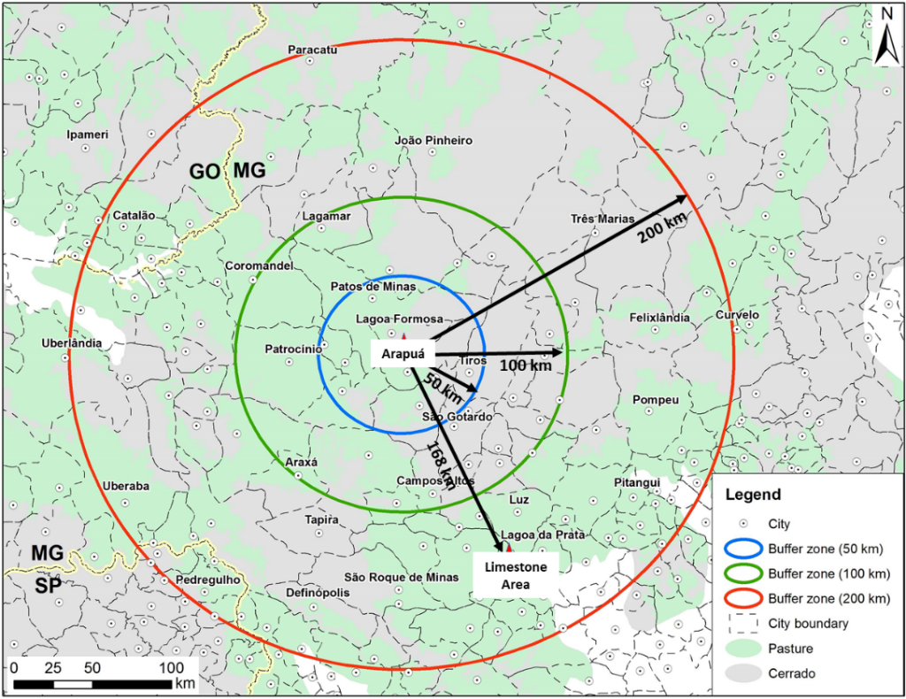
Growth – Limestone Project
Highly prospective project for the exploration of agriculture limestone
Limestone is a critical soil input used to neutralise soil acidity by raising its pH levels - it is estimated that for each tonne of fertiliser, three tonnes of limestone are needed
Located in the municipality of Iguatama, Minas Gerais
Minas Gerais is the second largest consumer of agricultural limestone using circa 5Mtpa*
Complements Arapuá which is c.168km to the northwest
The Project will benefit from Harvest’s established facilities and its regional presence/commercial activities given most of its clients also use limestone
Fast-tracking to production
Preliminary assessment of the project’s geological potential planned to establish the best approach for a cost-effective exploration programme
*The Ministry of Agriculture, Livestock, and Food Supply (MAPA)

Slide 17


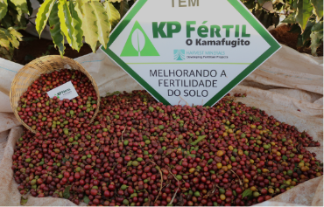
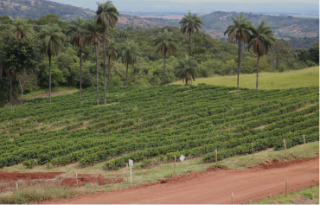
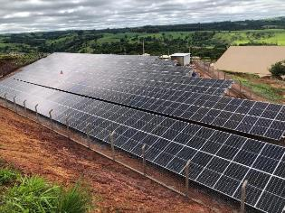
ESG Committed – Zero Carbon Strategy
Natural, organic product with minimal environmental impact
No water used during production & no tailings disposal
No contaminants including chloride and salt
Low leaching reduces groundwater contamination
Slow release product with residual effect
Low carbon emissions
Used locally meaning that very little transport is required
Product increases crop yields and productivity, with benefits including reducing the need for deforestation
A carbon-free company
New solar power facility provides all the power requirements
    Benefits include an estimated 7% savings in operating expenditure v FY21 figures and mitigation of energy price fluctuations
Off-set initiatives include the planting of thousands of native trees
Received the London Stock Exchange’s Green Economy Mark, which recognises Harvest’s contribution to the global green economy & efforts to support the transition to a net zero economy.
Input Approval Programme in accordance with main organic production guidelines (US, European, IFOAM, Japanese, Canadian, Brazilian & Demeter Standards).

Slide 18
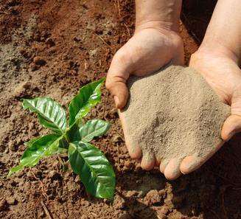
Investment Case
Long-life, flagship project in the heart of Brazil’s agricultural market
Produces unique, certified natural & organic product with proven advantages
Rapidly building brand awareness & geographic reach
Sales showing 46% CAGR over the last three years and starting 2022 with healthy order book in line with robust market fundamentals
Strengthening balance sheet
Revenue generating, low cost & high margin operation
Focused on growth
Two value accretive acquisitions complement flagship project
Robust ESG credentials
First Brazilian company to be awarded The London Stock Exchange’s Green Economy Mark
Exceptional team
Proven in-country and operational experience

Slide 19

www.harvestminerals.net
UK office
Level 1
20 North Audley Street
London, UK
Brazilian office
Av. Jornalista Ricardo Marinho 360, sala 113
Ed. Cosmopolitan Barra da Tijuca
Rio de Janeiro, Brazil
https://www.linkedin.com/company/harvest-minerals/
@HarvestMinerals

